Slide 1
Zillow’s Home Value Prediction – Kaggle Competition
711/219
Bill Yu

Slide 2
Overview
0. Objectives
1. Data Preparation
1. Exploratory Data Analysis
2. Imputing missing values
3. Feature Selection and Engineering
2. Model Iteration
1. Data modeling
2. Model Performance
3. Feature importance
4. Observations after modeling
3. Future improvement

Slide 3
Objectives
The goal is to predict the log error as a target values. Zillow is asking you to predict the log-error between their Zestimate and the actual sale price, given all the features of a home. The log error is defined as
logerror=log(Zestimate)−log(SalePrice)

Slide 4
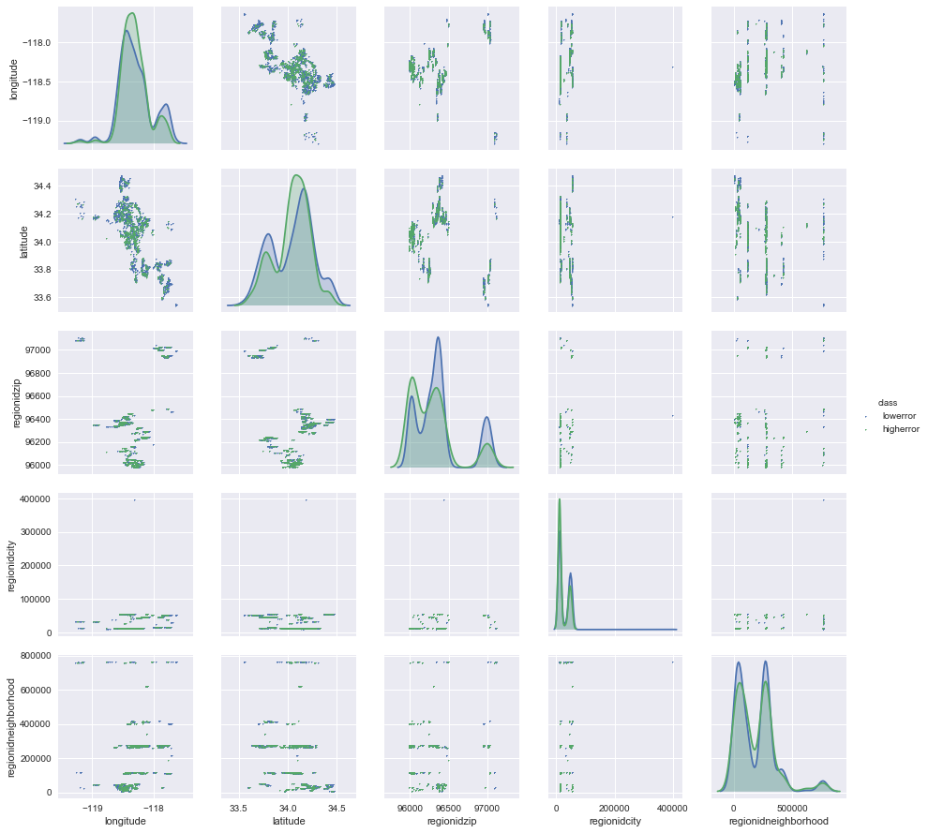
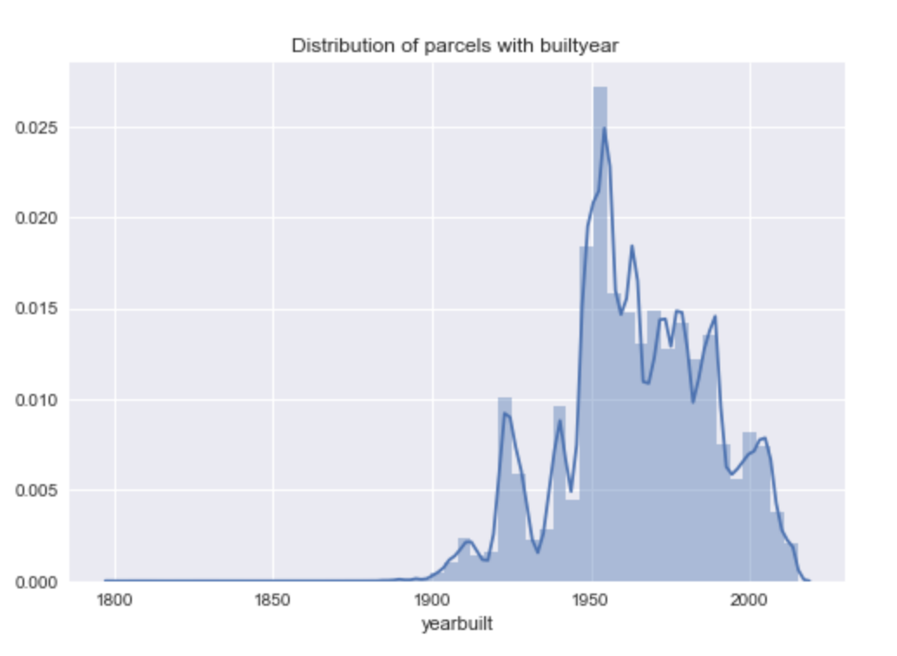
Exploratory Data Analysis
1. Run seaborn to preview the distribution of each features
2. Extract features that I subjectively think may be important

Slide 5
Imputation Strategy
 | Binary | Fill in 0 | Mode | Median | Random Distribution | KNN
Reasoning | Impute 0 and 1. Assuming most 0 because of rareness of existence | Rareness of existence | Mode for discrete numeric | 1. Median if data is spread out 2. Mean for continuous variables | Choose the highest two majority as a conservative plan | Geo info
Usages | True or false, and 0 and 1 | unimputable null value | Small % of missing values | Wide spread of observation | Choose among dominant values | Commercial /residential coding
Examples | Fireplace flag | Fireplace cnt, poolcnt | Region city, land use id | Room count/sqft | # of stories | Land use code

Slide 6
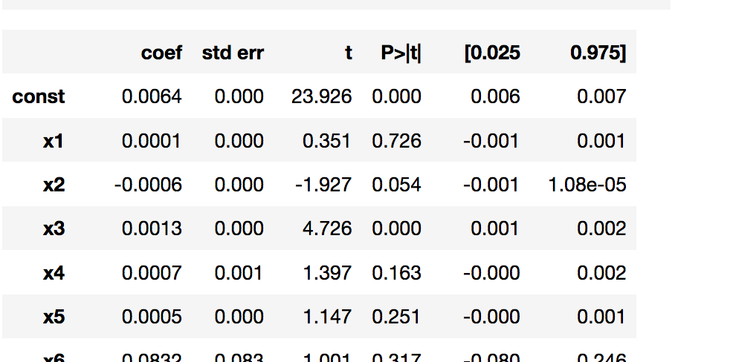
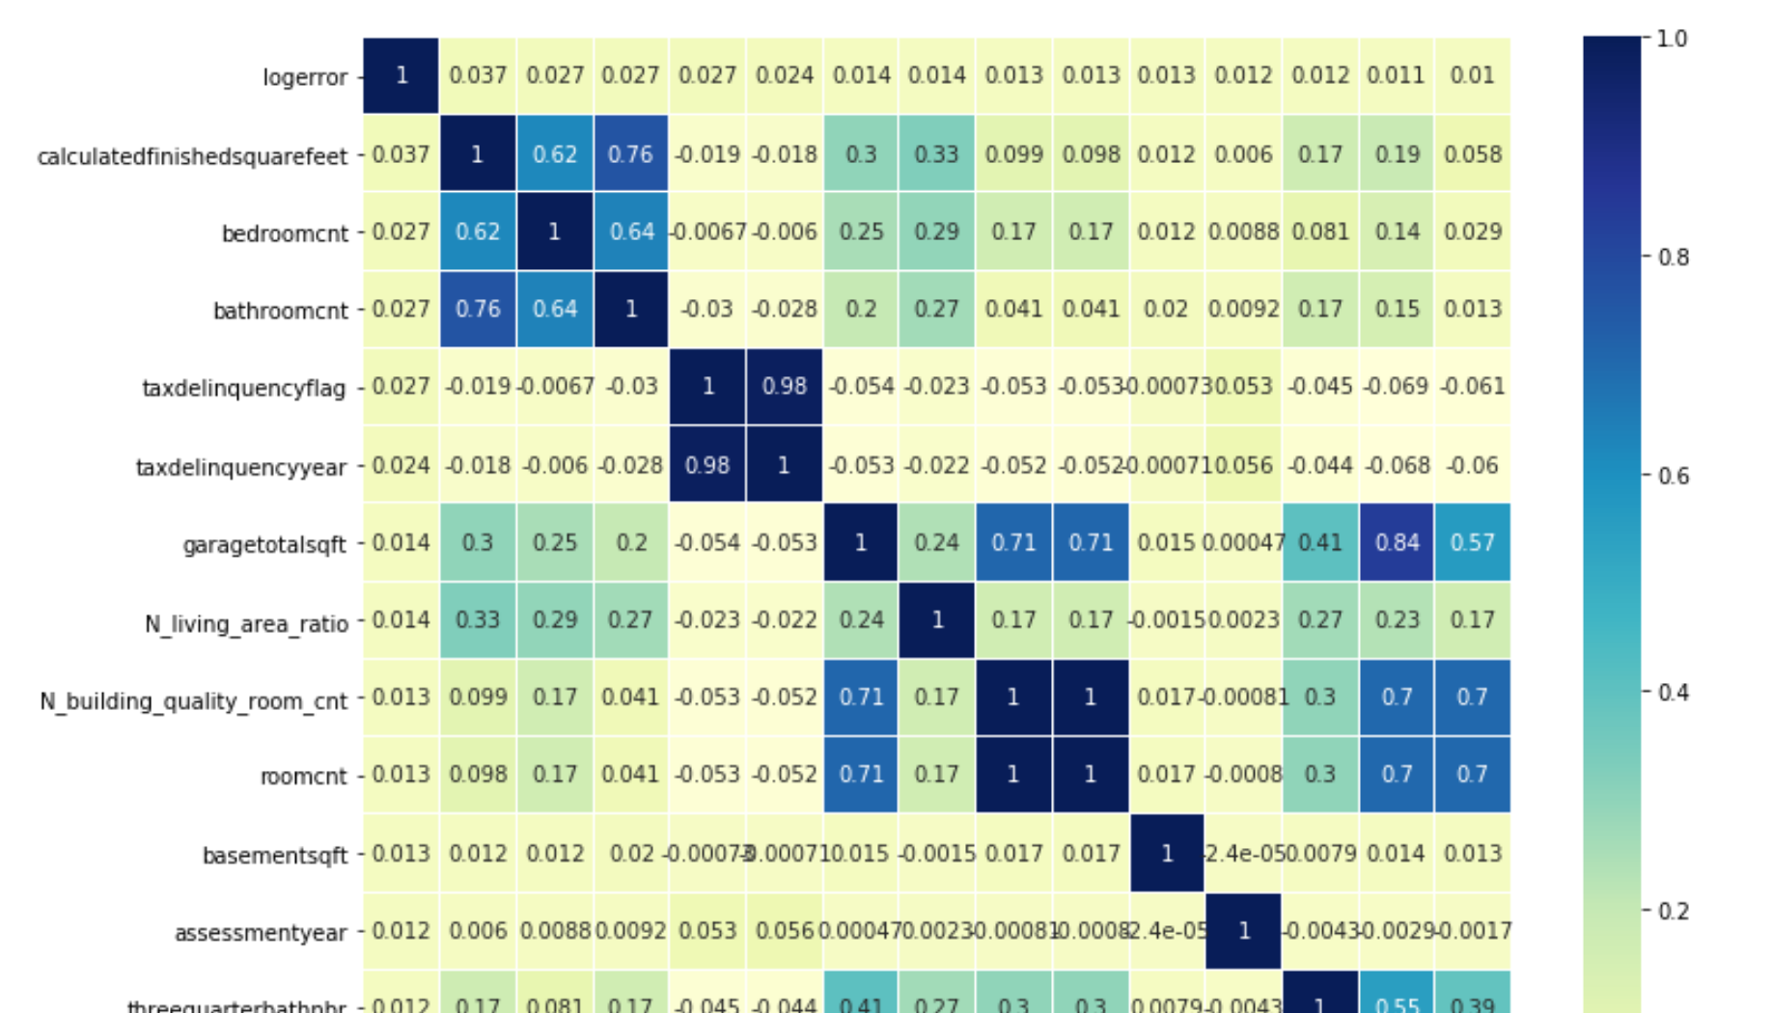
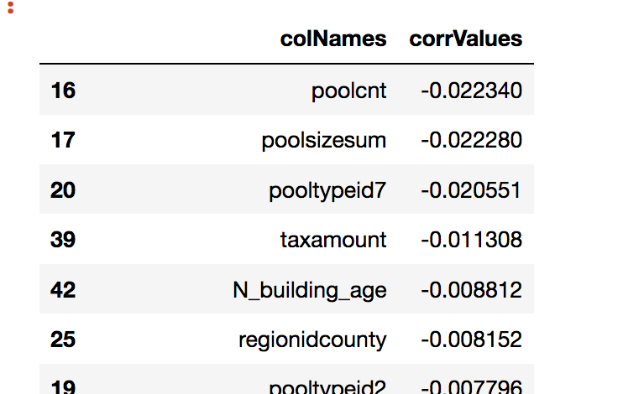
Feature Selection and Dropping Strategy
Missing values %:
1. missing too many values,
2. no predicting capability in the feature importance
3. high p-values
(e.g. story type id, pool typd id)
Duplication: avoid multicollinearity and repeated information.
(e.g. finishedsquarefeet12, finishedsquarefeet12,
finishedsquarefeet12, fullbathcnt..)
Results
18 features in columns are removed
0.5% of total rows are dropped due to unimputable null value

Slide 7
Feature Engineering
1. One-hot-encoding: Convert string to numeric values
(e.g. Property country land use code)
2. Information compression:
reduce numbers in category and avoid getting dummies variables
(e.g. some code type is combined as mixed, home, Unfinished, New)
3. Value and liability ratio: ideas on debt-to-profit ratio and average usage of the properties. 11 new features are created
(e.g. property tax value ratio = tax value count / tax amount
living space ratio = square feet / total square feet
…..)

Slide 8
Data modeling
Preparation
1. Train data set: combined properties 2016 and 2017 with target values in train
2. Test data set: 2016 and sample file
3. he test set is large than the train set, and test set always need to impute the missing values
Normalization
1. Standard scaler in features variables
2. Log transformed the target values
Modeling
1. Linear regression
2. Random Forest
3. Cat boost (does not require one-hot-encoding )

Slide 9
Model performance in kaggle
 | Parameters | Private Score | Public Score
Linear Regression | Default | error | error
Random Forest v2 | n_estimators = 1000 | 0.07806 | 0.06730
Random Forest v3 | n_estimators = 3000 | 0.07795 | 0.06716
CatBoost | Iteration=1000 Depth =9 | 0.07584 | 0.06507
CatBoost v2 | Iteration=1000 Depth =2 | 0.07603 | 0.06501
Light GBM | Default with mae | 0.07604 | 0.06507
Stacked model (average of two) | Random Forest v3 CatBoost v2 | 0.07646 | 0.06557
Ensemble model | Light GBM, CatBoost | 0.07879 | 0.06742

Slide 10
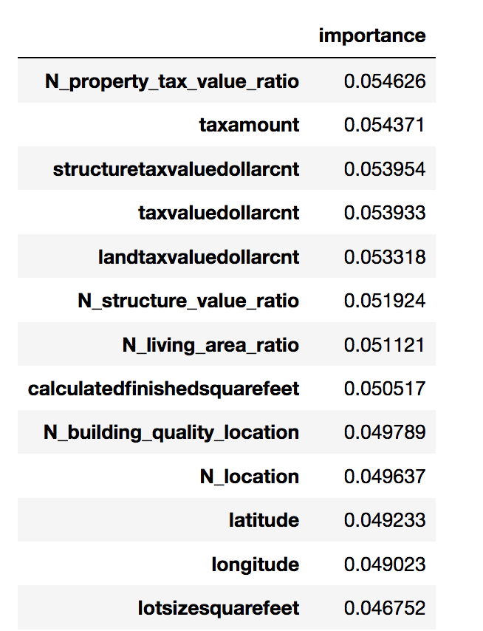
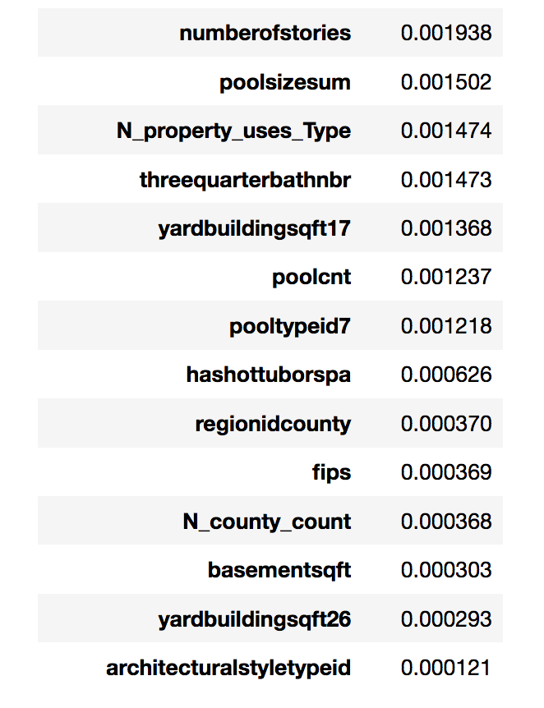
Feature importance in Random Forest
Low predictive features are relevant to amenities that reveal the degree of Gini impurity will descend during the leaf split
High predictive features centered in tax, square feet, and location

Slide 11
Observations after modeling
The test set is significantly larger than the train set. Linear regression is trained in a certain level of interval to predict in a train data set. Therefore, data extrapolation is a issues while using a test set to predict. For example, linear regression will not predict well anything beyond the train set because data extrapolation is varies in the test data and features are not in a linear relationship. Therefore, the forecast will be a linear line. However, polynomial features may alleviate this issues during the process of feature engineering.
Since the goal is to predict the log error, new features are not aim to predict the sale price. For example, pool count and size could be the outliners that could be attributed to overfitting.
Filling the missing values with KNN is time-consuming and categorical data need to be compressed before modeling. Some of the fields could just a a noise for the model.
Feature importance indicates the Gini impurity on the split. The performance measure may be the purity (Gini index) used to select the split points or another more specific error function. Having irrelevant features in data can decrease the accuracy of the models and make the model learn based on irrelevant features.
Training time will be a issues as the data set is large. Therefore, using fewer features and deploy the time-efficient models such as cat boost and light GBM are ideal to achieve this project
Ensemble model with iterations of different parameters in ensemble model could improve the scores from 0.065 to 0.064. However, finding a right tune could be challenging and time consuming.

Slide 12
Future improvement
Fine tune the ensemble model to improve the score from 0.065 to 0.064
Remove some location variables to minimize redundancy and noises such as flips and N-country after the modeling process
Visualize the geographic information to better understand the log error distribution.

